Slide 1
Fiber End Face Preparation
End face preparation is the first step before splicing or connecting the fibers through connectors.
Fiber end must be
Flat
Perpendicular to the fiber axis
Smooth
Techniques used are
Sawing
Grinding
Polishing
Grinding and Polishing require a controlled environment like laboratory or factory

Slide 2
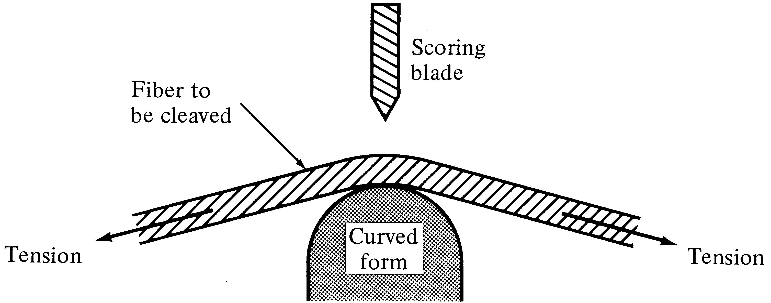
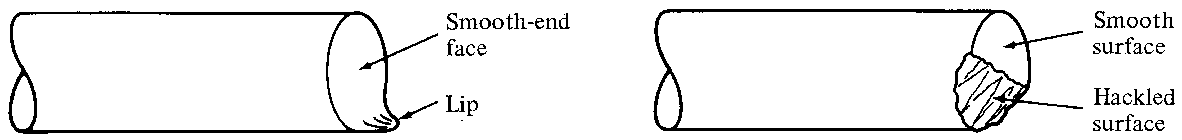
Controlled fracture techniques are used to cleave the fiber
Highly smooth and perpendicular end faces can be produced through this method
Requires a careful control of the curvature and the tension
Improperly controlled tension can cause multiple fracture and can leave a lip or hackled portion

Slide 3
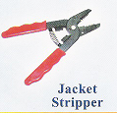
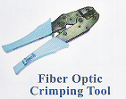
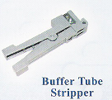
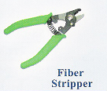
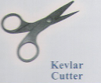
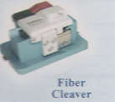
Tools Used For Splicing Of Fibers

Slide 4
Fiber Splicing:
A major consideration in all types of Fiber – Fibers connection is Optical loss
Encountered at interface.
A permanent joint formed between two individual fibers in the fields (or) factory
is known as fibers splices
Splices may be divided into two broad categories depends on splicing techniques.
Fusion Splicing (or) Welding
Mechanical Splicing

Slide 5
Fusion Splicing (or) Welding
Fusion splicing is accomplished by applying localized heating (by flame or electric arc) at interface between two butted, realigned fiber ends causing them to soften and fuse.
Three different types of splicing can be done
Fusion splicing
V-groove mechanical splicing
Elastic tube splice

Slide 6
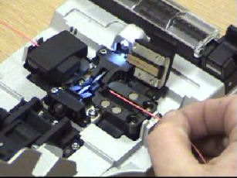
The Fusion Process
Once the fiber ends are prepared they are placed in the fusion splicer. Press the button and the machine takes care of the rest of the fusion process automatically
First the two fibers are aligned, you can see this on the photo
where a much magnified image shows the two fiber ends. The
display also shows how well the cleaver does its job of producing a
perfect 90 degree cut.

Slide 7
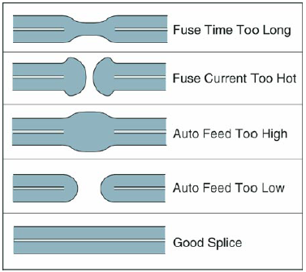
Screen Displayed

Slide 8
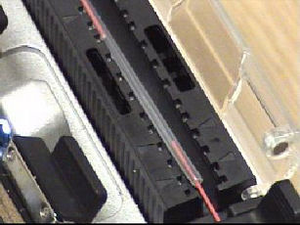
Protection
The protective tube gives physical protection to the splice and further protection is provided by placing the splice into a splice tray.

Slide 9
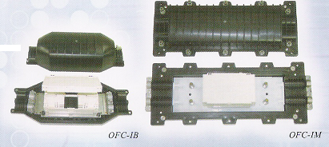
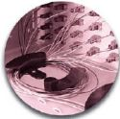
Once all of the fibers have been joined the whole tray is then fixed into a splice box which protects the cable joint as a whole and the cable clamps are then tightened to prevent any external forces from pulling on the splices.

Slide 10
